Slide 1


Solving an age old challenge -
Automating feature engineering
(with Gen AI and declarative feature framework)
Sergey Yurgenson, Head of Semantic Data Science Featurebyte
ODSC West , 2023

Slide 2

Agenda
Introductions
Check that everyone can connect
Data Semantics
Feature Ideation
Materializing Features
Creating Use Case

Slide 3
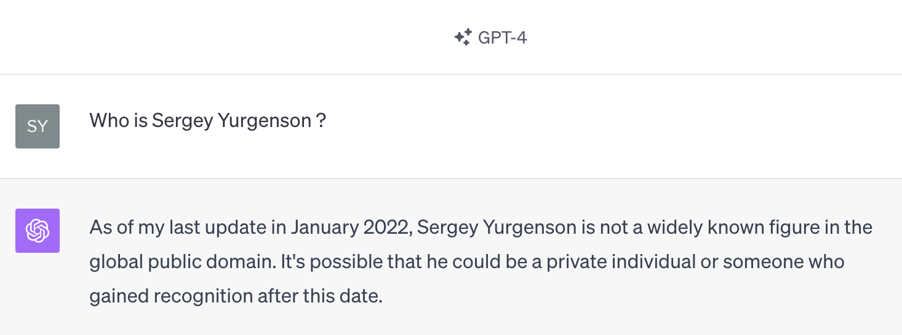
I am still not famous

Slide 4
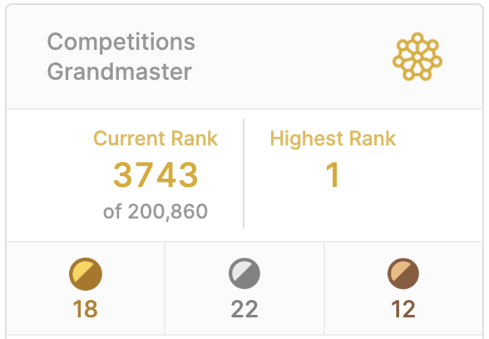
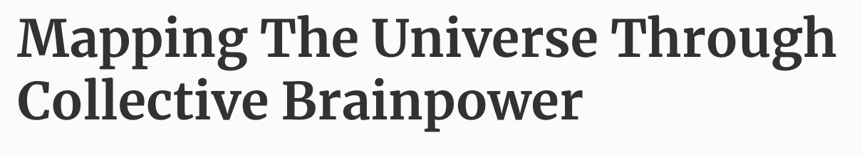




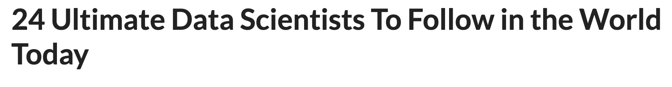

Slide 5

Workshop Goal
Introduce Ai-based FeatureByte Feature Ideation Engine using sample data
Ideate and create Feature List for ML project
Learn some cool feature engineering tricks

Slide 6

System Setup
Internet connection
Login username and password (https://demo.featurebyte.com/)
API token (available via the Enterprise GUI) (Security - User Access Token)
Notebook coding environment (https://hub.featurebyte.com/)

Slide 7


Files
Workshop notebook
Signal type definitions
https://github.com/featurebyte/featurebyte-workshops

Slide 8

Use Case
Fraud detection
On credit card transactions
Prediction target is the fraud status 30 days after the transaction occurred

Slide 9

Data Semantics
Great feature engineering is built on a foundation of data semantics
Log in to https://demo.featurebyte.com/
FeatureByte Enterprise - Explore
Tables
Entities
Special columns

Slide 10

Feature Ideation
FeatureByte Enterprise – Experiment
Feature Catalog
Primary Entity
Signal Types
Feature Themes

Slide 11
Inspiration: Entities
Gender
State
Customer
Card
Transaction Group
Primary entity for this use case
Transaction

Slide 12
Inspiration: Signal Types
Timing
Recency
Latest Event
Frequency
Attribute
Aggregate Statistic
Bucketing
Similarity
Stability
Attribute Change
Diversity
Location
See the signal type definitions file for details

Slide 13
Inspiration: Entities + Signal Types
Entity: Customer
Entity: Transaction
Signal: Attribute
Signal: Stability
Signal: Frequency
Signal: Diversity
Feature: gender, age
Feature: similarity of transaction descriptions over the latest 7 days vs. 168 days
Feature: count of transactions over the latest 7 days
Feature: standard deviation of transaction amounts over the latest 7 days
Feature: entropy of transaction descriptions over the latest 168 days

Slide 14

Automated Feature Ideation
Log in to https://demo.featurebyte.com/
FeatureByte Enterprise – Create – Feature Ideation
Run semantics detection
Generate feature ideas for windows of 7 and 168 days

Slide 15
Automated Feature Ideation
Advanced use of data semantics
Wide range of feature themes
Identification of duplicate (existing) features
AI-powered ranking of the relevance of feature ideas – specific to your use case
All feature ideas come with intuitive descriptions and human-readable code definitions
All feature ideas are customizable

Slide 16
Relevance Score
Mouseover the information icon next to a recommended feature’s relevance score
This explains the reasoning for the real-world relationship between this feature and the use case.
If you had chosen a different use case, FeatureByte would score the feature’s relevance differently.

Slide 17
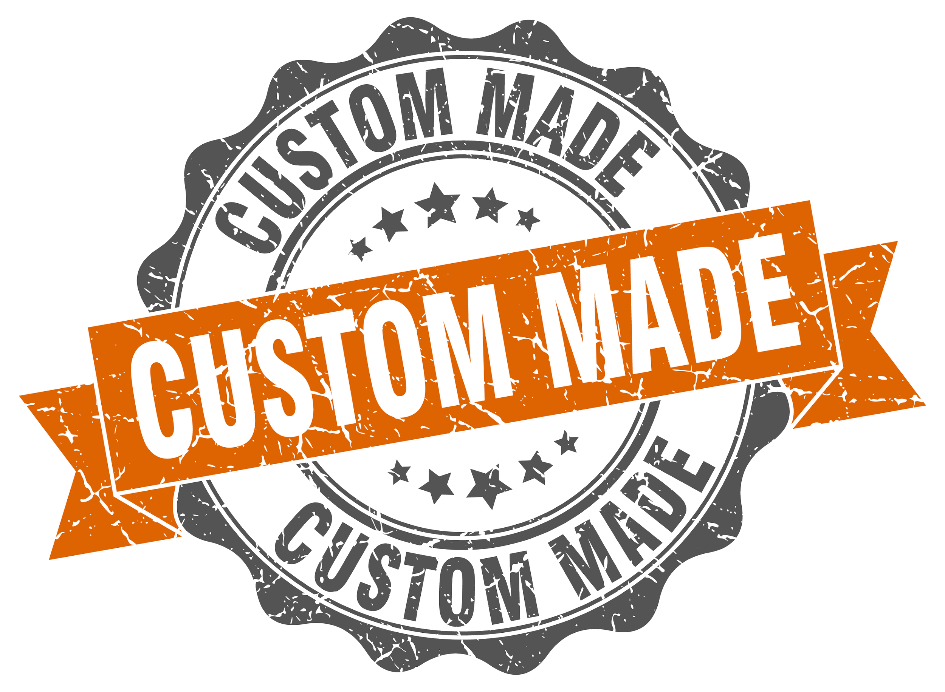
Customizing Features
Filter for Attribute signal types
Filter for Readiness is New
Select CUSTOMER_Age_band
Click Generate Notebook
Name the notebook “custom age feature”
Click Generate Notebook to download the file

Slide 18
10
Setup Jupyter connection to Featurebyte
Load the ODSC West Featurebyte workshop notebook into the FeatureByte Jupyter environment https://hub.featurebyte.com/
Edit second cell by specifying API token
Run first 4 cells

Slide 19
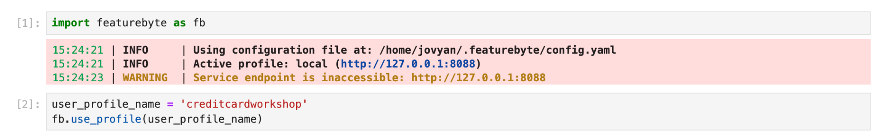
10
Customizing Features
Load the notebook into the FeatureByte Jupyter environment https://hub.featurebyte.com/
Add second cell to specify user profile name
user_profile_name = 'creditcardworkshop'
fb.use_profile(user_profile_name)

Slide 20
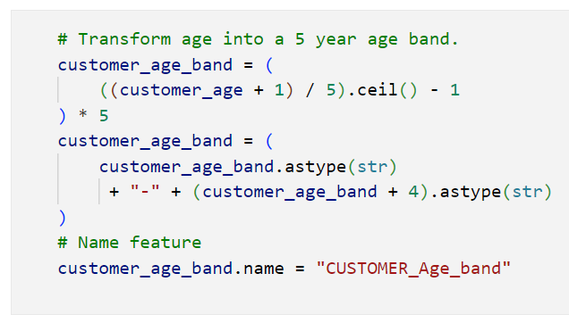
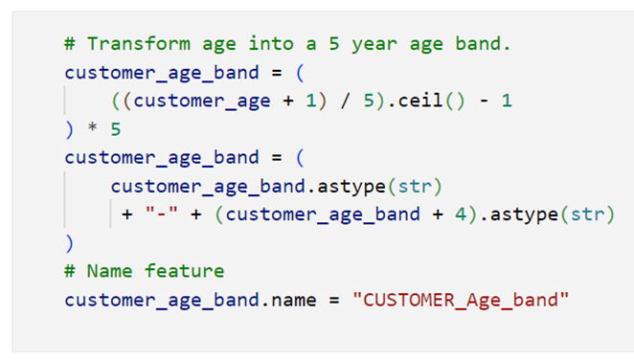
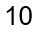
10
Customizing Features
Load the notebook into the FeatureByte Jupyter environment https://hub.featurebyte.com/
Edit the cell (with the code snippet shown on this slide) to * Use 10-year age bands * Change the feature name to “CUSTOMER_Age_Customized”
Change feature description
Run all of the cells in the notebook
9
“CUSTOMER_AGE_Customized”

Slide 21
Customizing Features
Open https://demo.featurebyte.com/
Open the feature catalog and find your new feature
View the feature themes

Slide 22

Reusing Features
Open https://demo.featurebyte.com/
Open the feature list catalog
Go to the feature list builder
Select a use case by selecting the transaction entity (Txn)
Add the template feature list
Go to the feature catalog
Add the top 2 unused features

Slide 23

Reusing Features
Go to “Suggestions” in the bottom RHS of the screen
Click on “additional signal is available for 18 themes”
Click on “Show Features” for the similarity feature type and select all
Click Review Feature List
Click Save list and give it the name “ODSC workshop features”

Slide 24
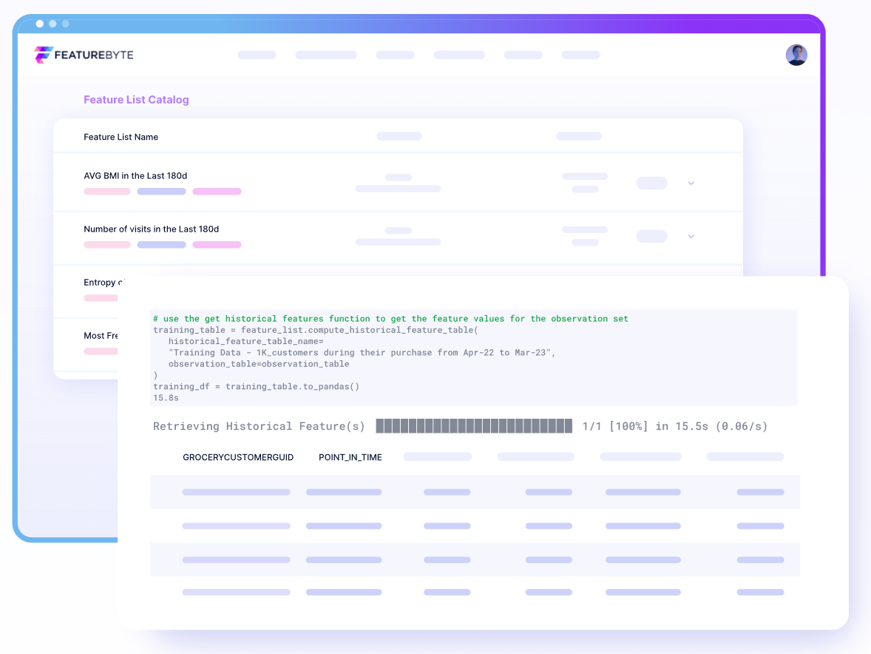
Declaring New Features
Load the workshop notebook into the FeatureByte Jupyter environment https://hub.featurebyte.com/
Run the cell to create an attribute signal
Run the cells to create a new feature with a diversity signal
Run the cell to create a new feature list and view a sample of the feature values

Slide 25
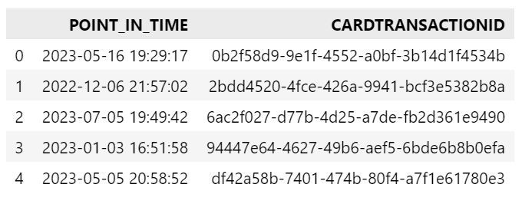
Observation Sets
Feature declarations tell FeatureByte how to calculate feature values
But feature calculations are not triggered until you tell FeatureByte which entities to calculate features for, and at which point in time
An observation set combines entity key values and historical points-in-time for which you want to materialize feature values.
Note that each entity has a serving name, and your observation set must use columns with those names

Slide 26
Observation Sets
Go to the workshop notebook
Go to the Observation Table section
Edit the template code to create an observation table
Run the code and view a sample of the table contents

Slide 27

Declare a Target
Go to the workshop notebook
Go to the Declare a Target section
Edit the template code to create a target
Run your code
Run the final cell in the section to materialize the target values, and view a sample

Slide 28

Create Training Data
Go to the workshop notebook
Go to the Training Data section
Run the first cell to load the feature list for the training data
Edit the template code to compute the training data
Run your code
Run the final cell in the section to view a sample of the training data

Slide 29

How to create new use case
Go to the workshop notebook in the FeatureByte Jupyter environment https://hub.featurebyte.com/
Go to the New Use Case section
Run the first cell to create new use case
Open https://demo.featurebyte.com/
Go to Feature Ideation section
Click on Use Case name and select Use Case you just created

Slide 30
Q&A

